Slide 1
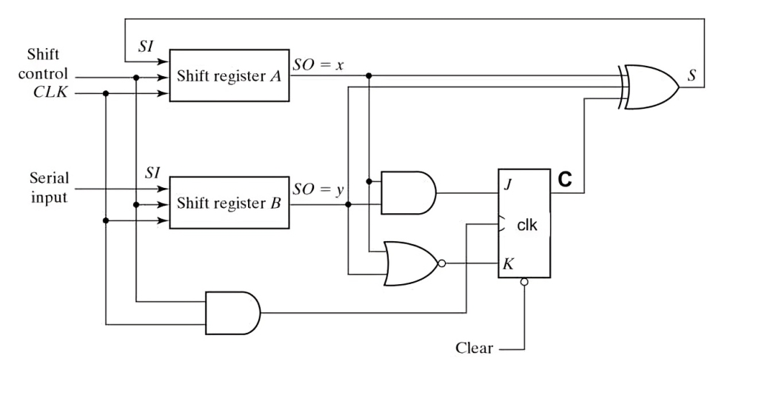
Ques. Shift Reg B in the circuit below receives alternating 0 and 1 at SI at each clock cycle. Reg A, & B is loaded with value 1010 at t = 0 (the state of all memory elements at t = 0 is shown in the partial timing diagram on the right).
Draw the timing diagram for register A. What is the sequence of values taken by register A for the next 20 cycles?
SI
0
A3
1
A2
0
A1
1
A0
0
B0
0
C
0

Slide 3
Problem Understanding
Register A: 4-bit parallel register, initially loaded with "1010" at t=0.
Serial Input (SI): Alternates between 0 and 1 each cycle.
Register B: 1-bit register; toggles (flips) on each clock.
C: Control bit, governs register A’s load/shift operation.
Goal: Draw register A’s content over 20 clock cycles; explain the evolution and dependencies at each stage.

Slide 4
Register A
Parallel load at t=0t=0: A3=1, A2=0, A1=1, A0=0.
On each clock, A3, A2, A1, A0 shift right; A3 receives SI.
Register B
Toggles each cycle (flip-flop): B0 alternates 0 → 1 → 0 → ...
Serial Input SI
Given as alternating values: 0, 1, 0, 1, ...
Control Bit C
Determined by AND/OR/NOT logic from shift register and combinational gates.
Controls register A’s shift/load

Slide 5
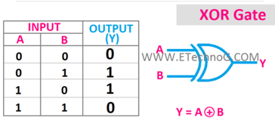
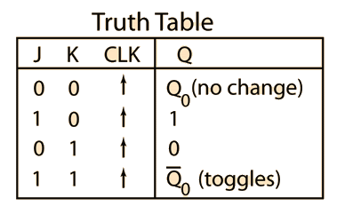
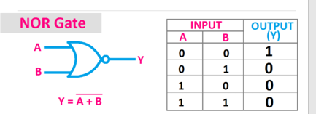
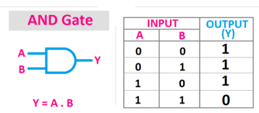
x.y

Slide 6
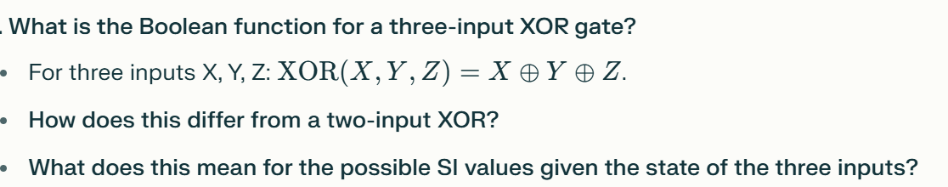
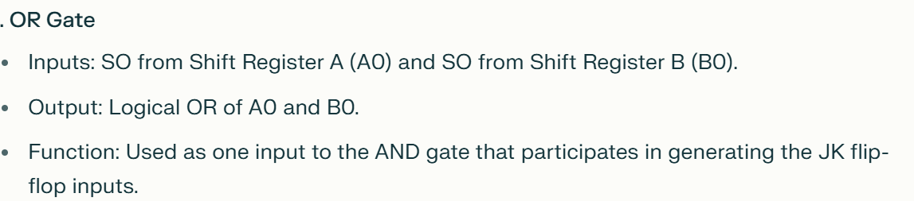

Slide 7
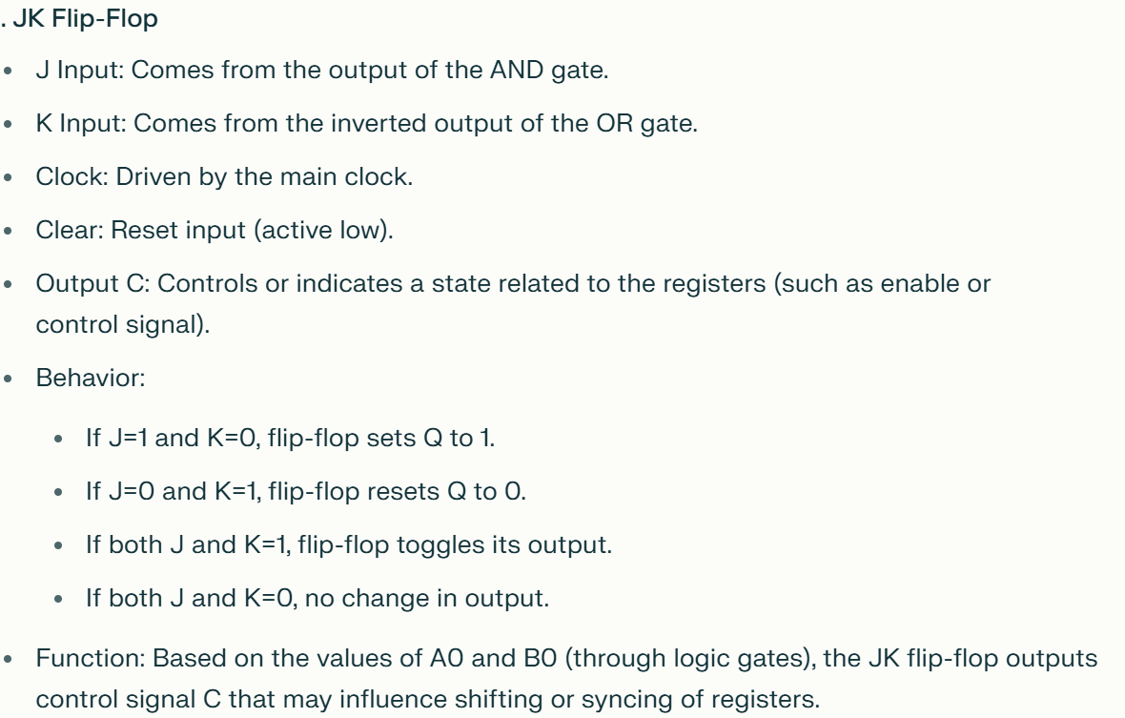
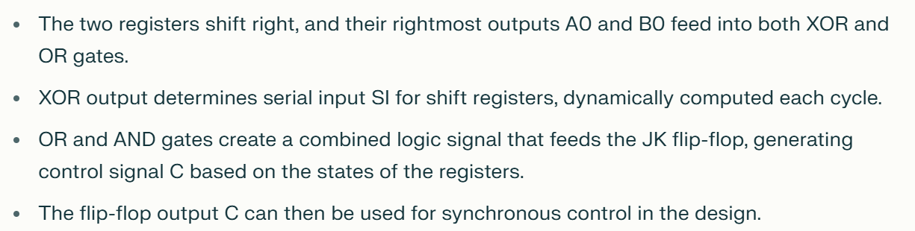

Slide 8
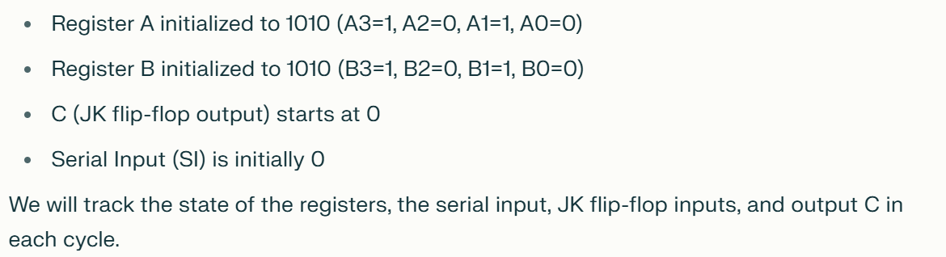
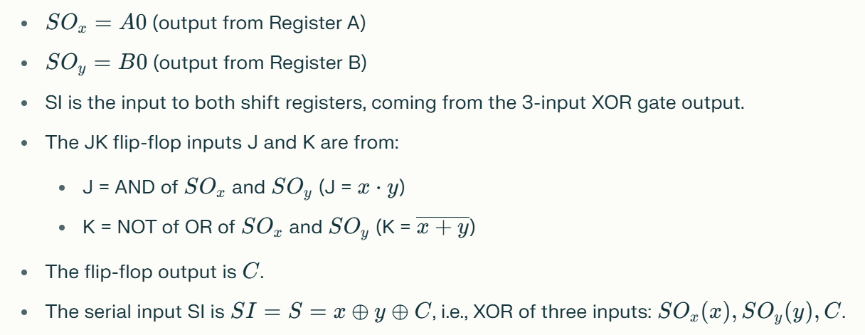

Slide 9
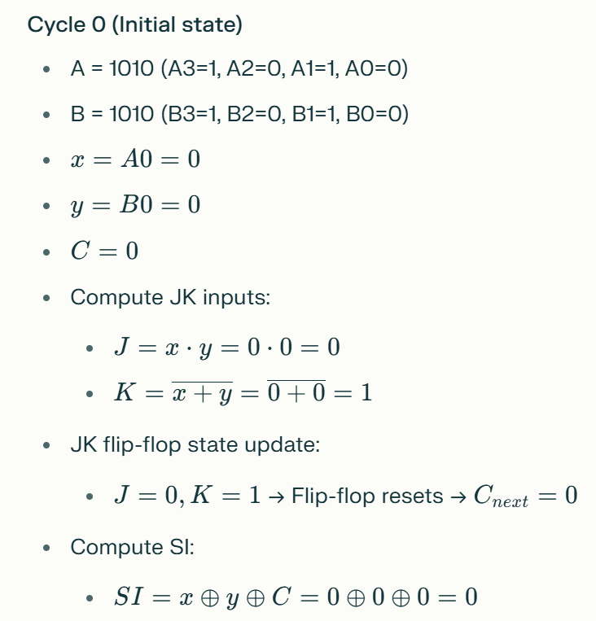
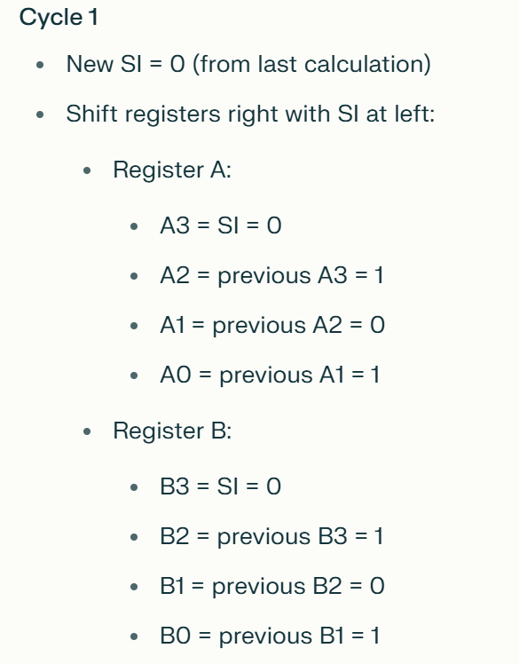
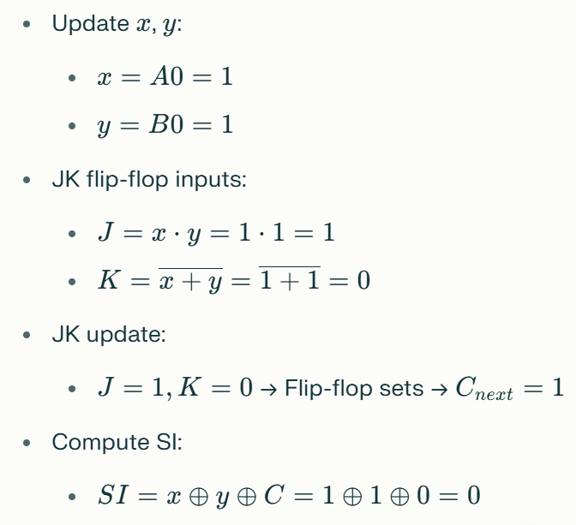

Slide 10
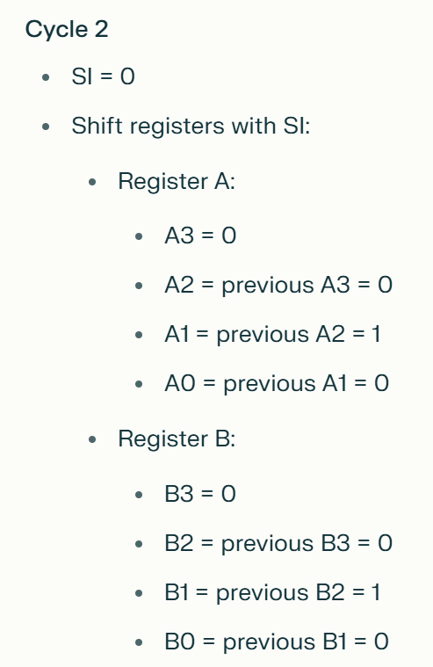
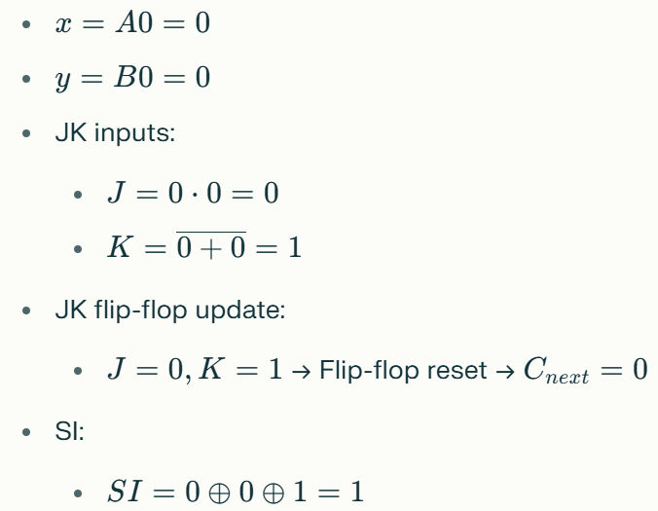

Slide 11
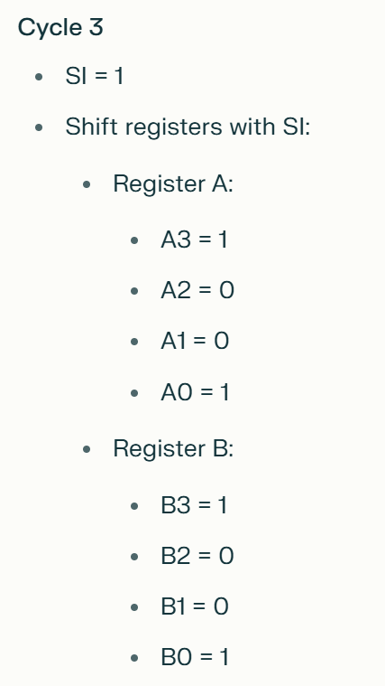
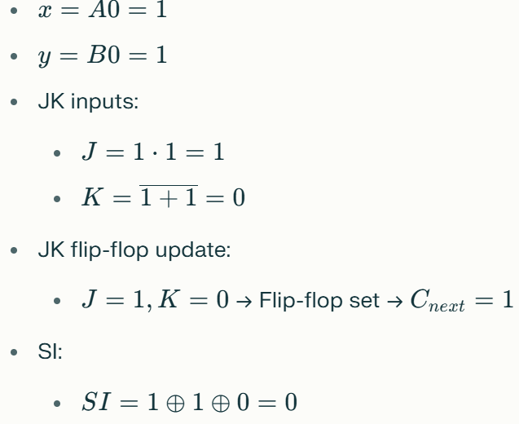

Slide 12
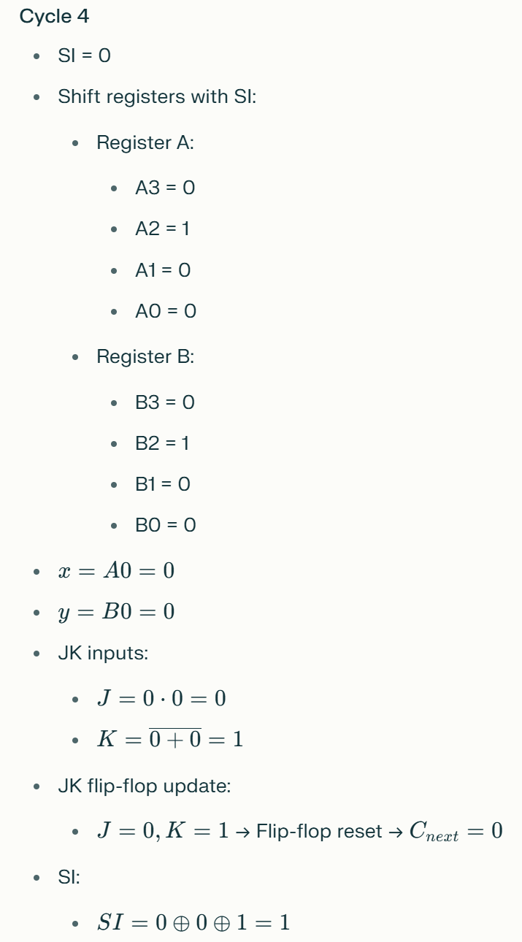

Slide 13
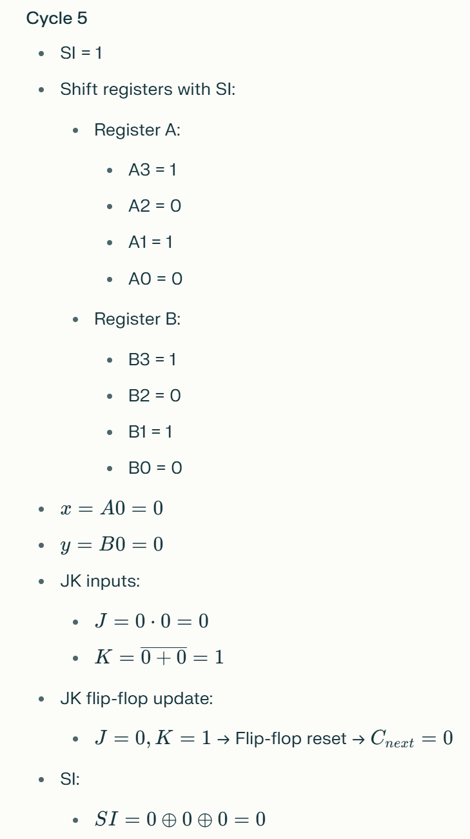

Slide 14
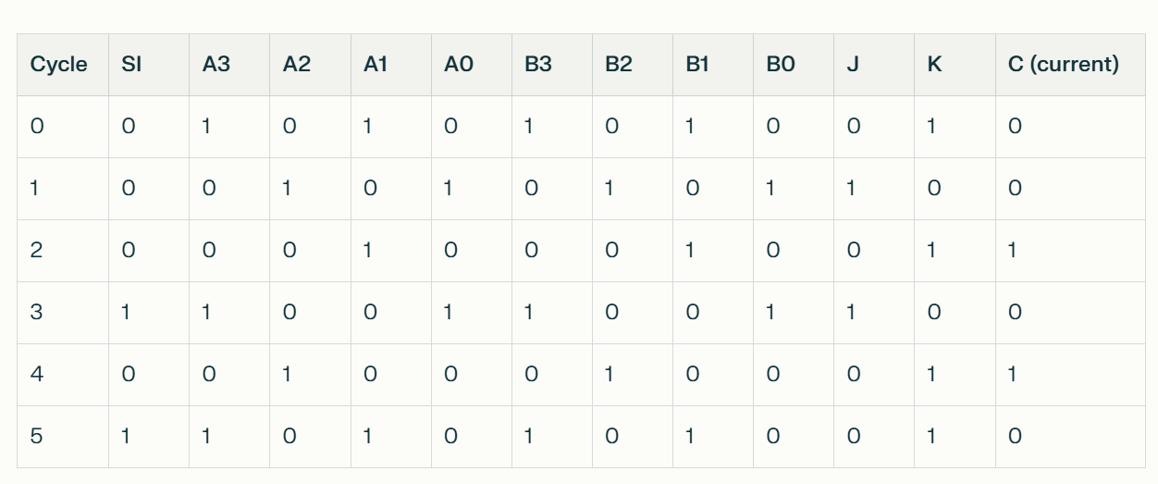

Slide 15
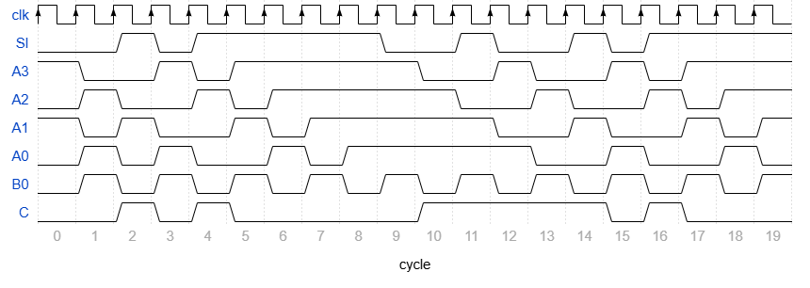
In each cycle:
B0 flips
SI → A3 → A2 → A1 → A0
C for the next cycle is updated, because it depends on state in current cycle
SI for current cycle is updated
Final timing diagram should look
like this:
SI
0
0
1
0
1
1
1
1
1
0
0
1
0
0
1
0
1
1
1
1
A3
1
0
0
1
0
1
1
1
1
1
0
0
1
0
0
1
0
1
1
1
A2
0
1
0
0
1
0
1
1
1
1
1
0
0
1
0
0
1
0
1
1
A1
1
0
1
0
0
1
0
1
1
1
1
1
0
0
1
0
0
1
0
1
A0
0
1
0
1
0
0
1
0
1
1
1
1
1
0
0
1
0
0
1
0
B0
0
1
0
1
0
1
0
1
0
1
0
1
0
1
0
1
0
1
0
1
C
0
0
1
0
1
0
0
0
0
0
1
1
1
1
1
0
1
0
0
0

Slide 16
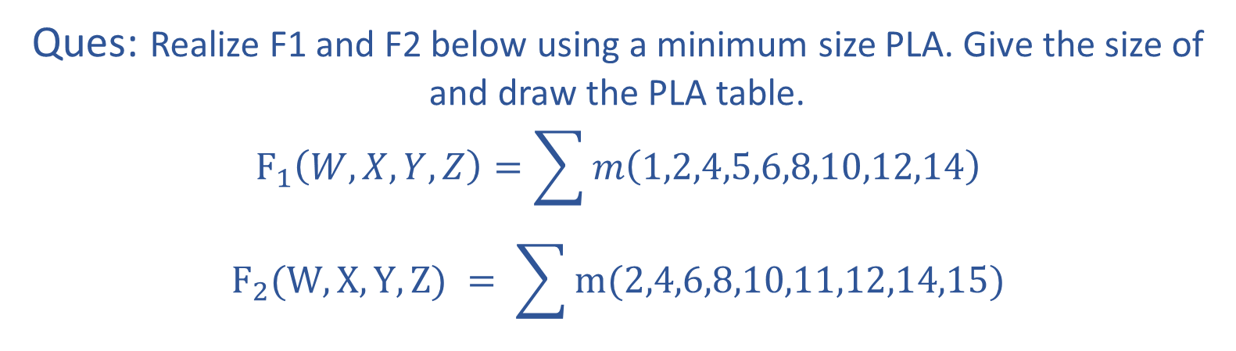
Ques: Realize F1 and F2 below using a minimum size PLA. Give the size of and draw the PLA table.
$$F_{1}\left(W,X,Y,Z\right)=\sum{m\left(1,2,4,5,6,8,10,12,14\right)}$$
$$F_{2}(W,X,Y,Z) = \sum{m(2,4,6,8,10,11,12,14,15)}$$

Slide 17
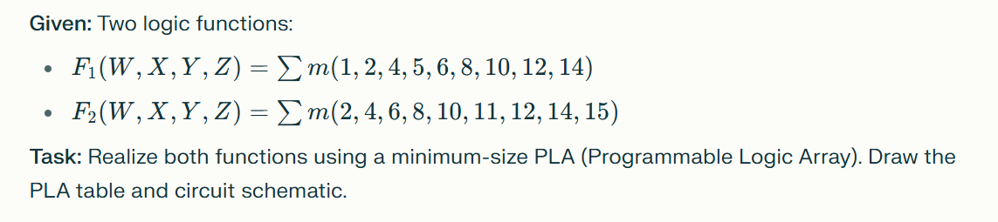

Slide 18
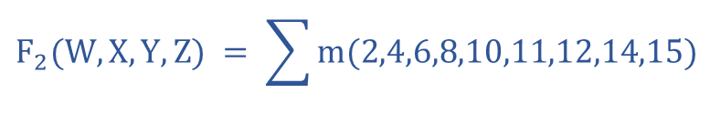
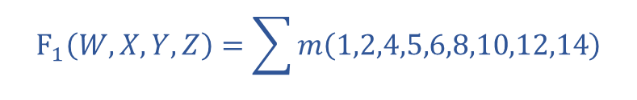


Solving K-Map for Boolean function F1 and F2:
$$F_{1}\left(W,X,Y,Z\right)=\sum{m\left(1,2,4,5,6,8,10,12,14\right)}$$
$$F_{2}(W,X,Y,Z) = \sum{m(2,4,6,8,10,11,12,14,15)}$$
F1
YZ
F2
YZ
WX
00 01 11 10
WX
00 01 11 10
00
01
11
10
0 | 1 | 0 | 1
1 | 1 | 0 | 1
1 | 0 | 0 | 1
1 | 0 | 0 | 1
00
01
11
10
0 | 0 | 0 | 1
1 | 0 | 0 | 1
1 | 0 | 1 | 1
1 | 0 | 1 | 1
$$F1= Y\overline{Z}+X\overline{Z}+W\overline{Z}+\overline{W} \overline{Y}Z$$
$$F2= Y\overline{Z}+X\overline{Z}+W\overline{Z}+WY$$

Slide 19
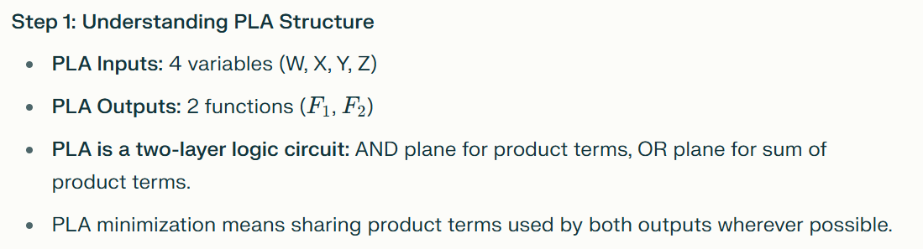
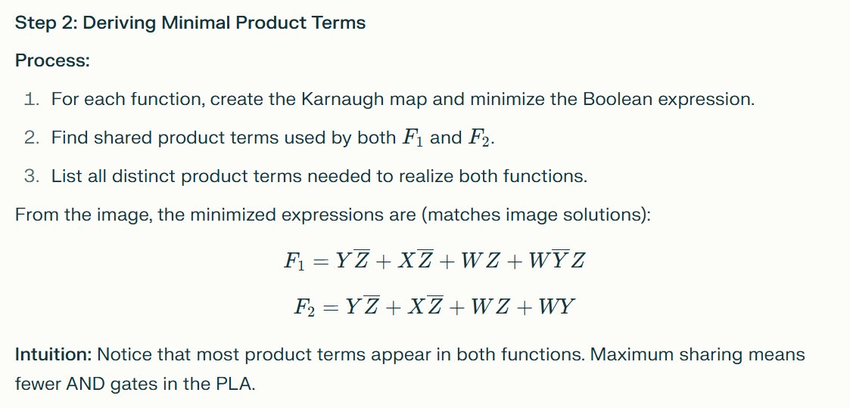

Slide 20
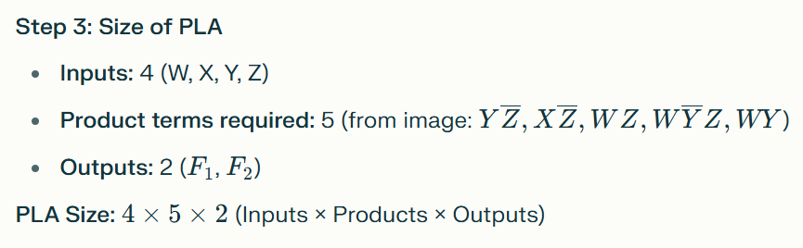
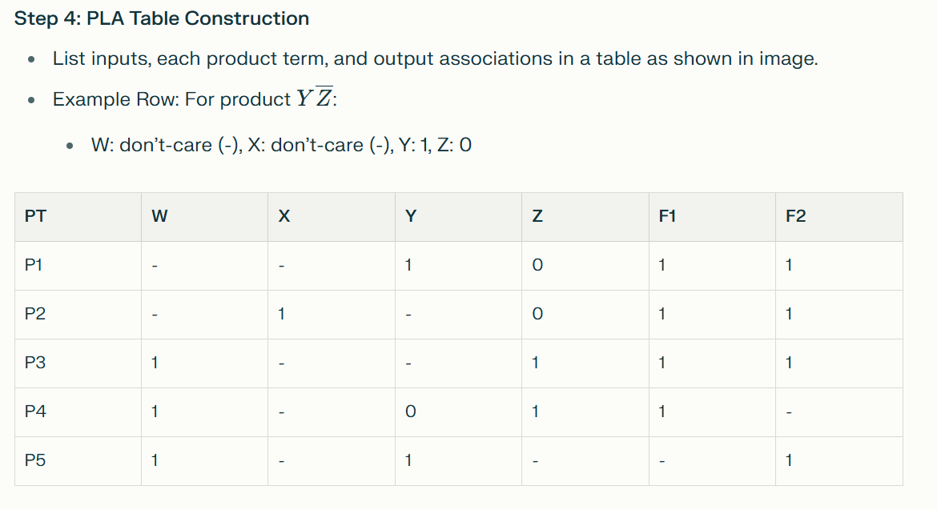

Slide 21
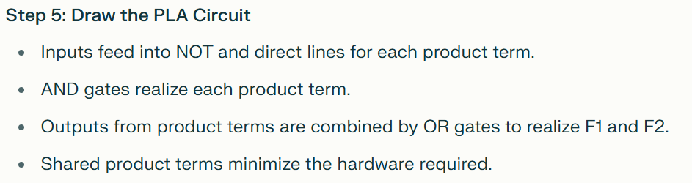
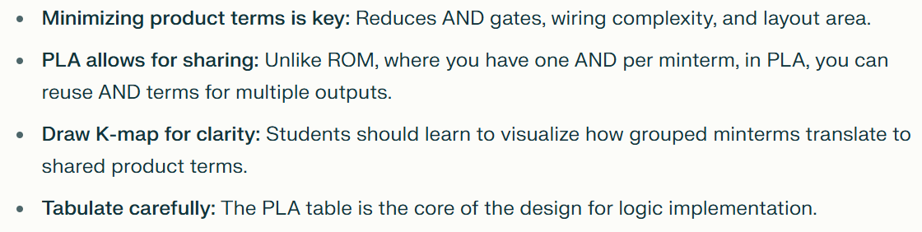

Slide 22
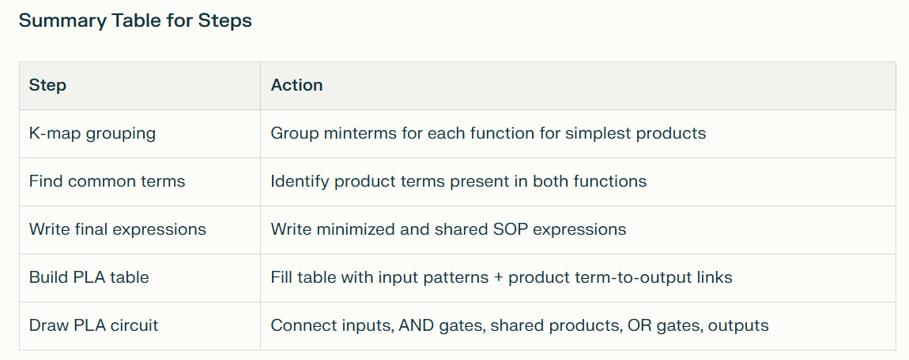

Slide 23


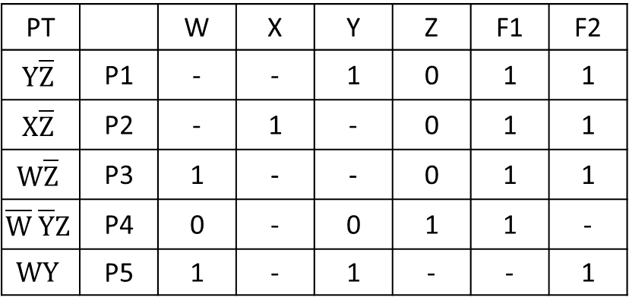
$$F1= Y\overline{Z} + X\overline{Z} + W\overline{Z} + \overline{W}\overline{Y}Z$$
PLA Table:
P4
PT |  | W | X | Y | Z | F1 | F2
$$Y\overline{Z}$$ | P1 | - | - | 1 | 0 | 1 | 1
$$X\overline{Z}$$ | P2 | - | 1 | - | 0 | 1 | 1
$$W\overline{Z}$$ | P3 | 1 | - | - | 0 | 1 | 1
$$\overline{W} \overline{Y}Z$$ | P4 | 0 | - | 0 | 1 | 1 | -
$$WY$$ | P5 | 1 | - | 1 | - | - | 1
$$F2= Y\overline{Z} + X\overline{Z} + W\overline{Z} + WZ$$
P1
P2
P3
P5
Size: 4 x 5 x 2
Output
Input
Product Terms

Slide 24
W
X
Y
Z
0
F1
F2
0

Slide 25
Ques. Design a 1-bit serial in and serial output (SISO) subtractor circuit using shift registers and J-K Flipflops.

Slide 26
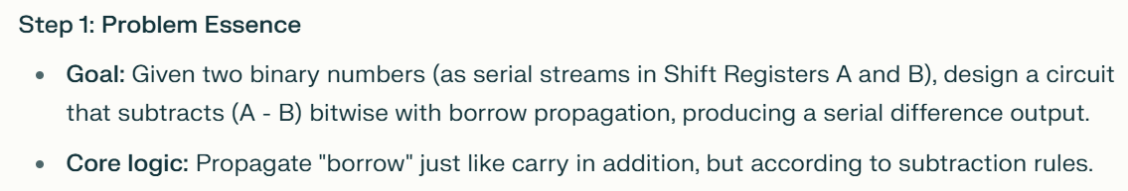
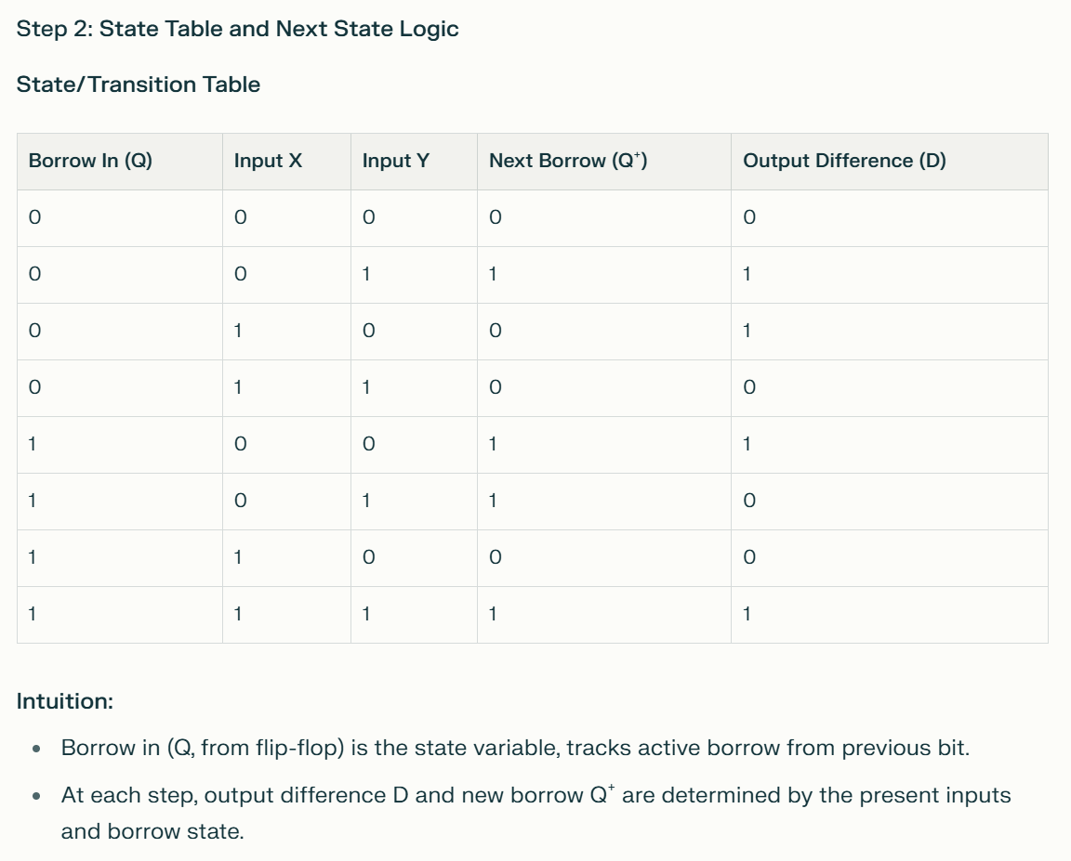

Slide 27
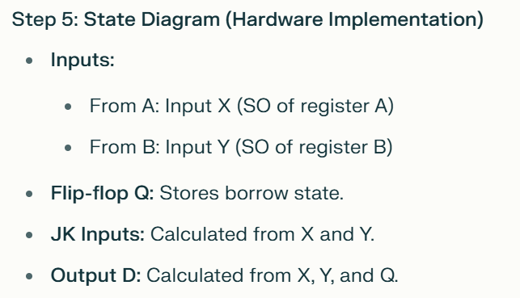
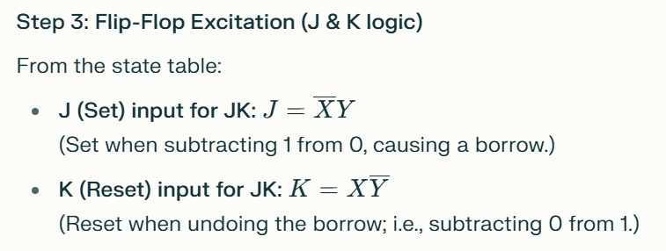
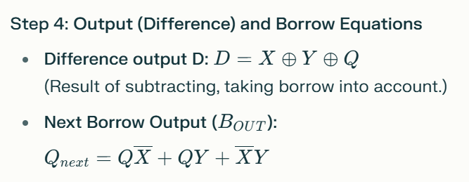
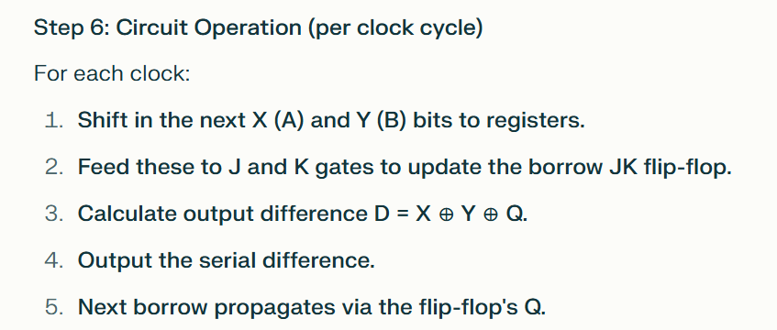

Slide 28
Step 7: Visualization
Circuit shows two shift registers for A and B (serial in, serial out).
X and Y from A and B go into:
  NOT gates and AND gates to construct J and K for the borrow flip-flop.
  XOR and AND gates (final output) for the serial difference.
Output D is calculated and taken as single-bit serial out.
Borrow is stored in J-K flip-flop, fed back for next bit subtraction
Intuition:
Why use a JK flip-flop?
  It stores the "borrow" bit—needed on every serial stage for correct subtraction, just like a full subtractor.
  JK can replicate T or D flip-flop behavior as needed for serial logic.
Serial transmission makes bit order and borrow propagation critical:
  Only one "state memory" needed (the borrow).
Parity with full subtractor truth table:
  For any cycle, serial difference output matches full subtractor result (borrow handled by JK, difference by XOR chain)

Slide 29

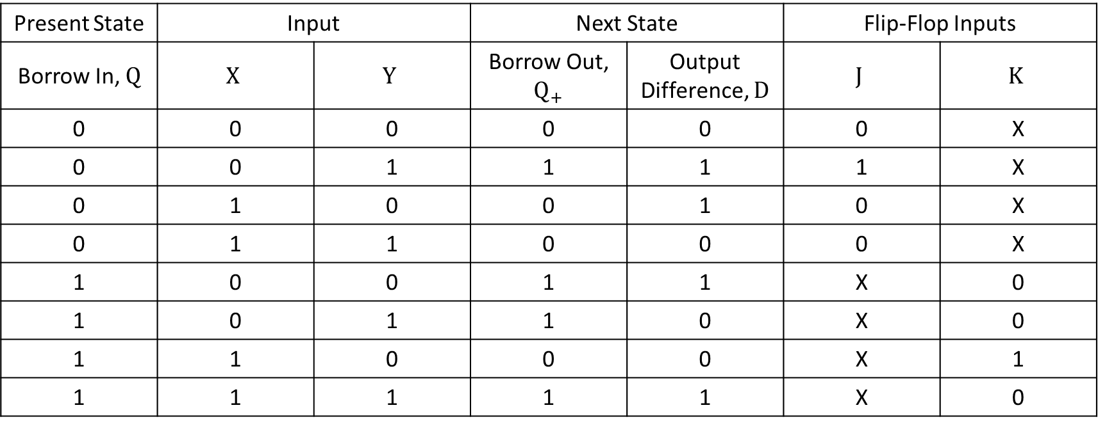



Present State | Input |  | Next State |  | Flip-Flop Inputs
Borrow In, $Q$ | $$X$$ | $$Y$$ | Borrow Out, $Q_{+}$ | Output Difference, $D$ | $$J$$ | $$K$$
0 | 0 | 0 | 0 | 0 | 0 | X
0 | 0 | 1 | 1 | 1 | 1 | X
0 | 1 | 0 | 0 | 1 | 0 | X
0 | 1 | 1 | 0 | 0 | 0 | X
1 | 0 | 0 | 1 | 1 | X | 0
1 | 0 | 1 | 1 | 0 | X | 0
1 | 1 | 0 | 0 | 0 | X | 1
1 | 1 | 1 | 1 | 1 | X | 0
J
XY
K
XY
D
XY
Bout
XY
Q
00 01 11 10
Q
00 01 11 10
Q
00 01 11 10
Q
00 01 11 10
0
1
0 | 1 | 0 | 0
X | X | X | X
0
1
X | X | X | X
0 | 0 | 0 | 1
0
1
0 | 1 | 0 | 1
1 | 0 | 1 | 0
0
1
0 | 1 | 0 | 0
1 | 1 | 1 | 0
$$J= \overline{X}Y$$
$$K= X\overline{Y}$$
$$D=X ⨁ Y ⨁ Q$$
$$B_{OUT}= Q\overline{X}+QY+\overline{X}Y$$

Slide 30
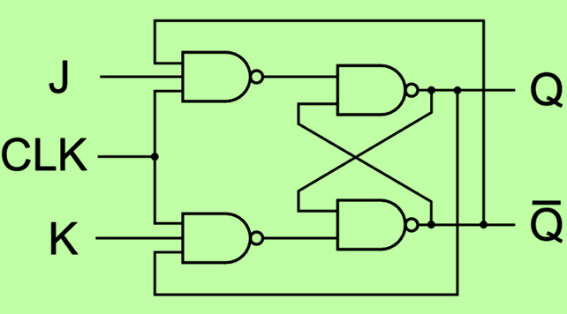



SI SO
A
Shift Register A
X
D
J
$$Q_{n}$$
SI SO
B
Shift Register B
Y
K
$$\overline{Q_{n}}$$
$$CLK$$

Slide 31
